Slide 1
Sagemaker Autopilot and Model Hosting

Slide 2
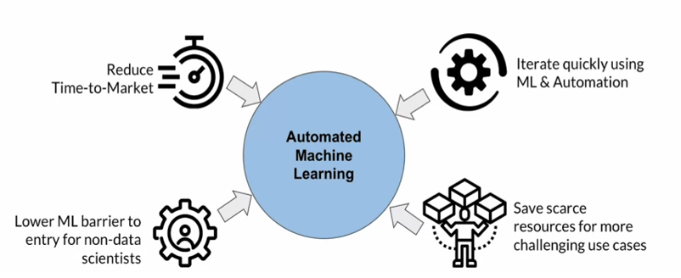
Auto ML
AutoML leverages machine learning to automate various tasks in the machine learning workflow. It reduces time to market by automating resource-intensive tasks such as data transformation, feature engineering, and model tuning.
AutoML empowers non-data scientists to build machine learning models without requiring extensive data science expertise.
AutoML enables rapid iteration in model development through automation, streamlining the majority of tasks in the workflow.
AutoML combined with cloud computing helps overcome compute resource constraints, allowing for parallel model training and tuning. Data scientists can focus on tackling complex and challenging machine learning problems, as AutoML handles routine tasks.

Slide 3
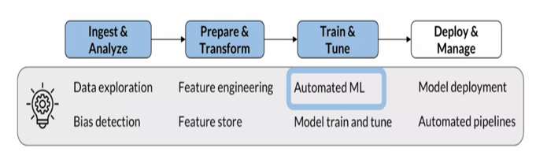
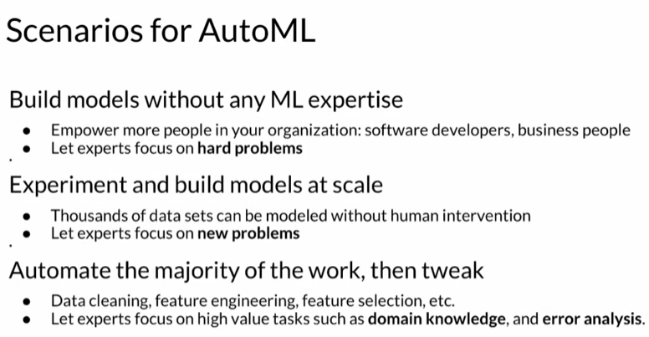
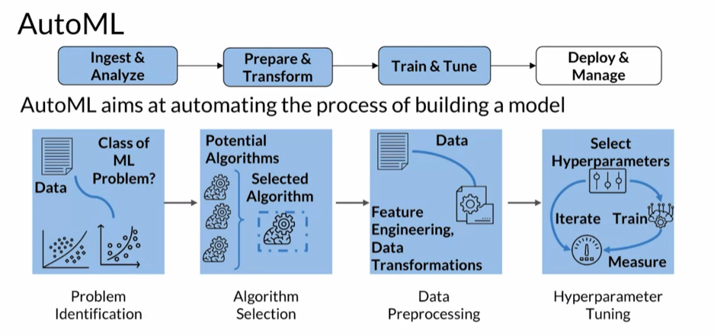
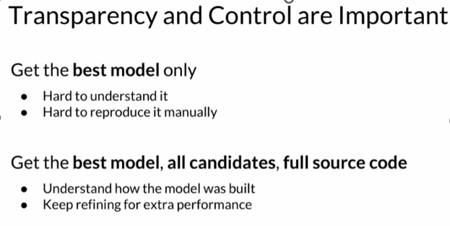
ML Workflow
Machine learning workflows typically involve data ingestion, problem definition, data exploration, algorithm selection,
data preparation, model training, and hyperparameter tuning.
AutoML automates many of these tasks to find the best- performing model for deployment.

Slide 4
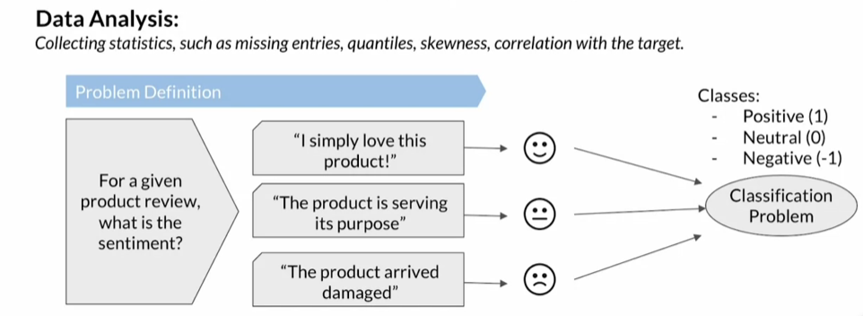
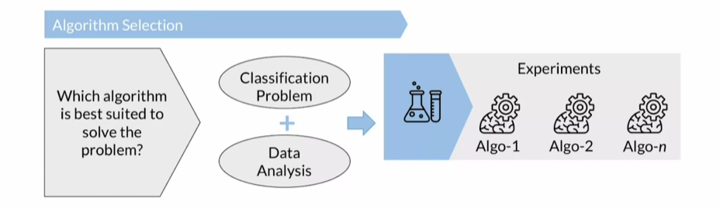
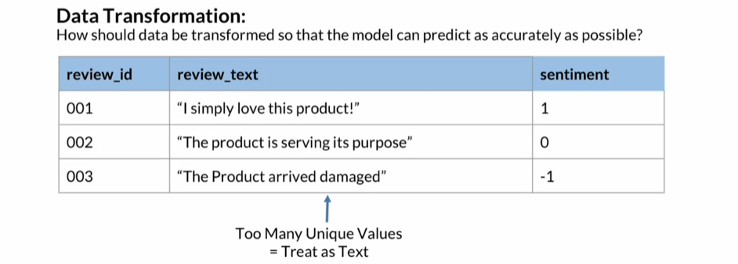
ML Workflow
Steps :
The workflow starts with data ingestion and problem definition, where you determine the type of machine learning problem (e.g., classification or regression).
Algorithm selection involves analysing data and choosing suitable algorithms based on data characteristics and the problem at hand.
Data preparation includes transformations like text processing, feature extraction, and addressing class imbalances.

Slide 5

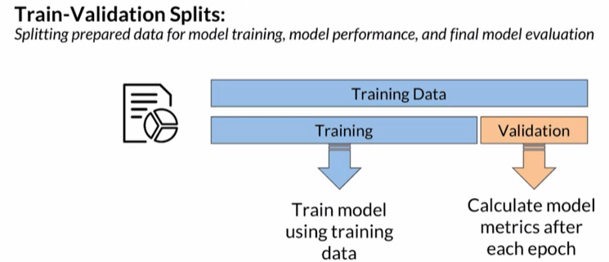
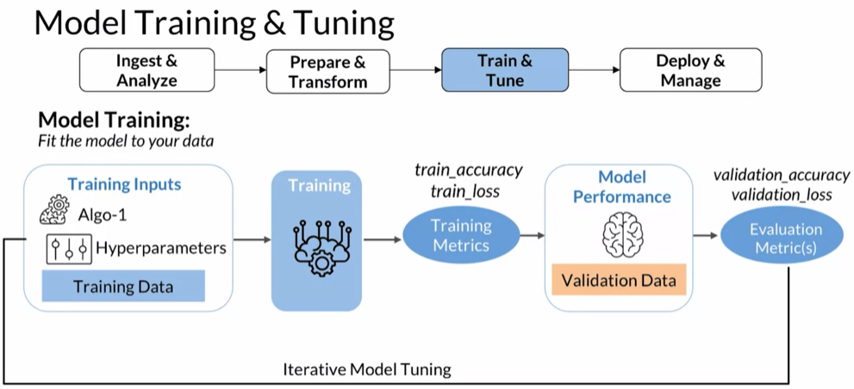
ML Workflow
Data preparation includes addressing class imbalance by implementing techniques like changing performance metrics, resampling, generating synthetic data, or algorithm-specific hyperparameter tuning. In data preparation, you decide how to handle class imbalance, especially when certain classes are significantly larger or smaller than others.
After data preparation, the dataset is split into training and validation sets. The training set is used for model learning, while the validation set helps evaluate model generalization and fine-tune hyperparameters. The validation set is crucial for assessing how well the model performs on unseen data and calculating metrics such as validation accuracy and validation loss.
Model training and tuning involve iterative experiments to find the best combination of data, algorithms, and hyperparameters. This process continues until an optimal model is achieved.

Slide 6
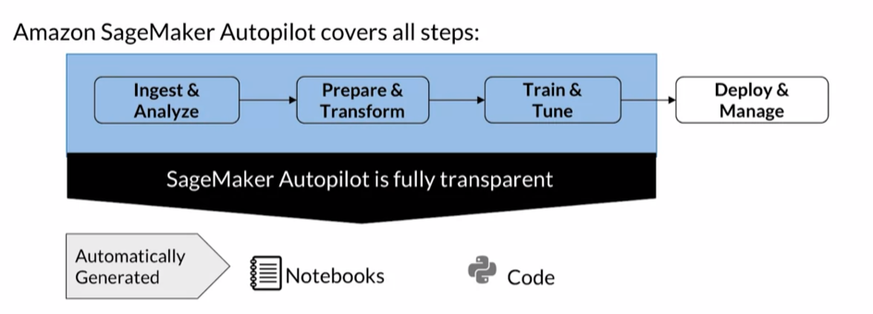
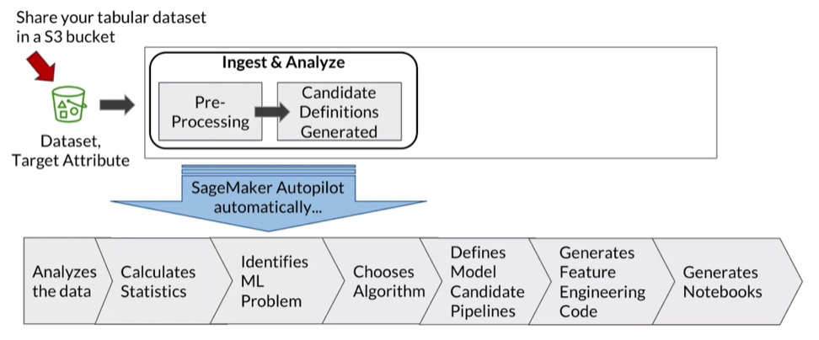
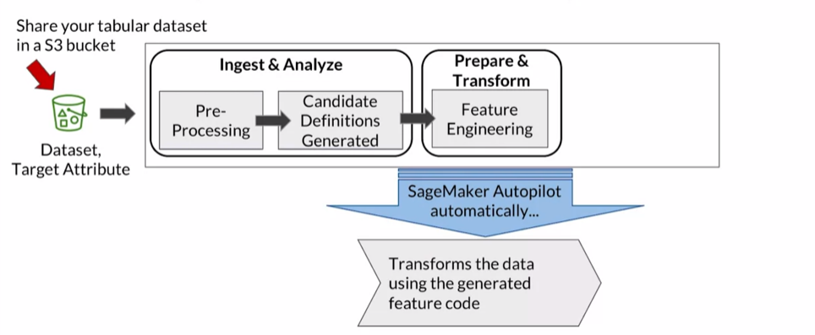
AutoML with AWS Sagemaker
The Autopilot workflow begins by uploading tabular data to an Amazon S3 bucket, specifying the target attribute (e.g., product review sentiment).
Autopilot analyzes the data, identifies the machine learning problem (e.g., classification or regression), and selects the most appropriate algorithm, including options like linear learner, XGBoost, and deep learning.
Autopilot generates feature engineering code to transform the data into a suitable format for the chosen algorithm.
Two types of notebooks are generated: a data exploration notebook detailing data insights and potential issues, and a candidate generation notebook containing preprocessing steps, algorithms, and hyperparameter ranges.

Slide 7
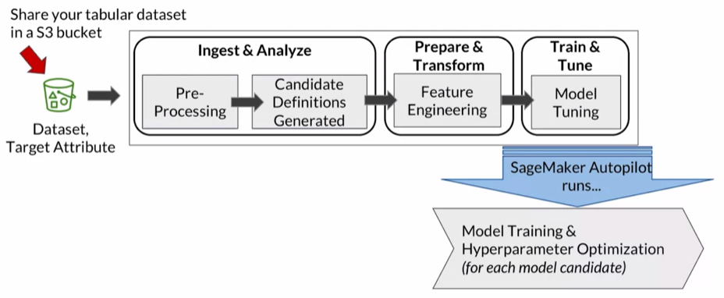
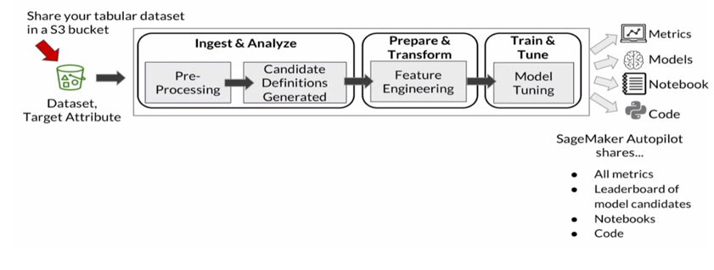
AutoML with AWS Sagemaker
SageMaker Autopilot handles class imbalance and can produce accurate models even with imbalanced datasets containing as few as 500 data points. Users can run Autopilot in various modes, from fully automatic to semi-automatic, allowing for human intervention in feature engineering and model selection.
Autopilot provides a leaderboard of candidate models with metrics, offering recommendations for the best-performing model. Complete visibility into feature engineering code, algorithms, and optimized hyperparameters ensures control and transparency in the model-building process.

Slide 8
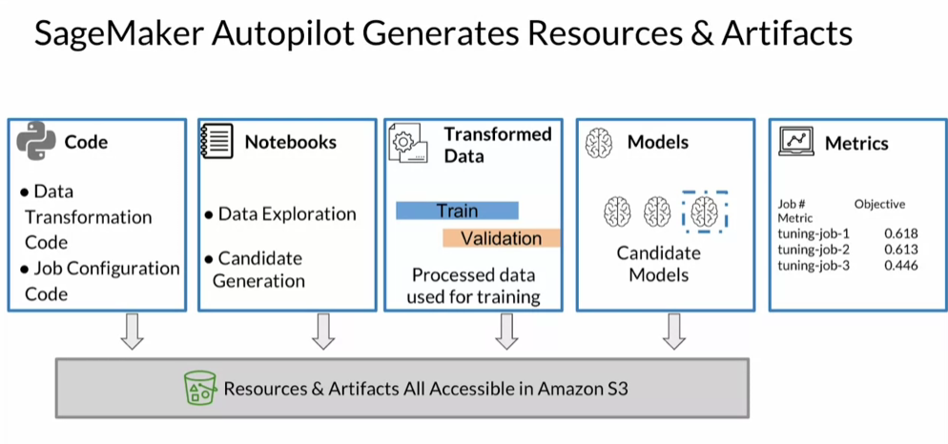
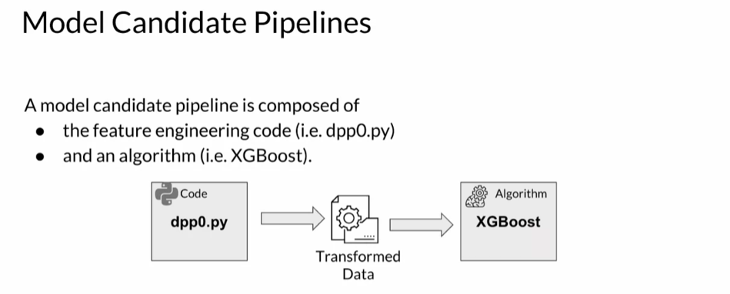
Autopilot generates resources and artifacts automatically upon completing a job. These artifacts include data transformation code and configuration code for data transformation and training.
Data exploration and candidate generation notebooks provide insights into data analysis and the steps for each candidate model. These artifacts offer visibility into each candidate and can be used for additional model refinements.
Autopilot creates training and validation datasets as a result of the data transformation code.
All resources and artifacts are stored in the specified S3 bucket. Autopilot runs multiple experiments to identify the best-performing candidate model. Trained model artifacts are stored in S3 for later use. Notebooks can be accessed both in S3 and the studio console.
Autopilot produces a leaderboard with metrics to easily identify the top-performing candidate.
Autopilot generates multiple model candidate pipelines, each combining feature engineering code, algorithms, and hyperparameter ranges. Hyperparameter tuning jobs are performed to find the best hyperparameters for each candidate pipeline.

Slide 9
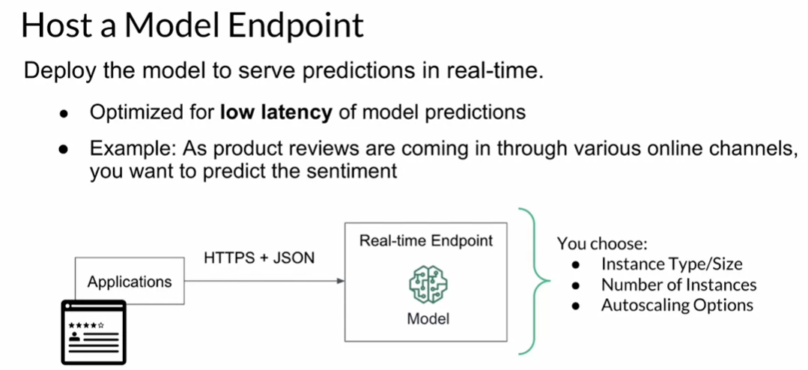
Model Hosting

Slide 10
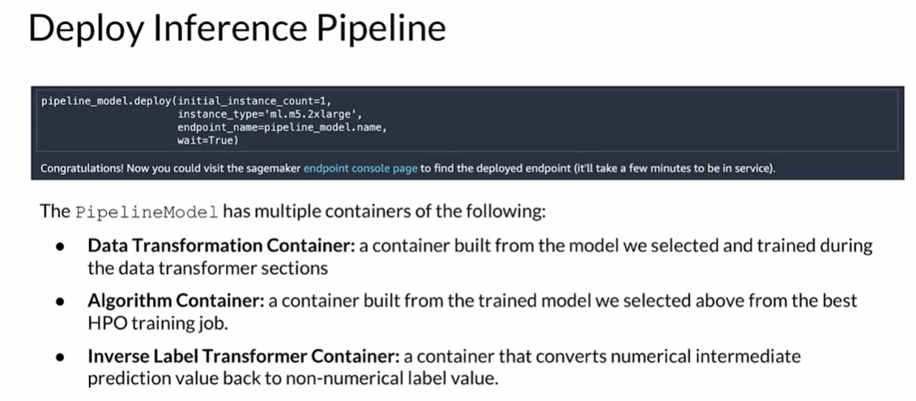
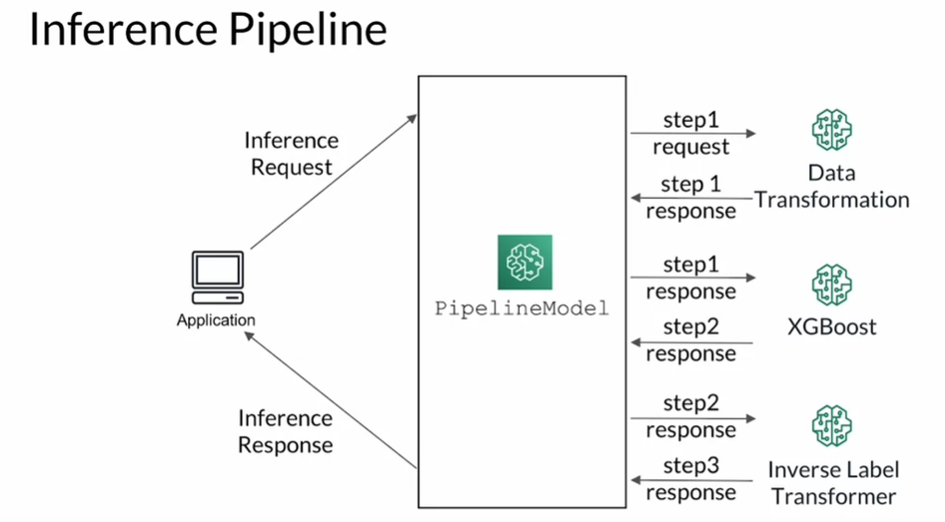
Model Hosting
Model hosting involves deploying machine learning models for real-time consumption. SageMaker supports both batch and real-time deployments for various use cases.
Real-time deployment ensures that the model is continuously available to serve predictions on incoming data. Example use cases include sentiment analysis of product reviews from websites, social media, or emails, enabling quick organizational responses.
Model hosting includes a serving stack with a trained model and a hosting stack. The hosting stack often comprises a proxy or web server to interact with the serving code and the model.
Models are made accessible through endpoints, which serve client applications via real-time API requests.
After comparing candidate pipelines from Autopilot, the best-performing model can be deployed. A pipeline model consists of multiple containers for data transformation, the trained model, and inverse label transformation.
SageMaker's inference pipeline enables hosting multiple model components behind the same endpoint. It includes the data transformation model, product classification model, and the inverse label transformer.
When an inference request is received, it passes through the data transformation model and then sequentially through other models. The final result is sent back to the client application.

